Slide 1







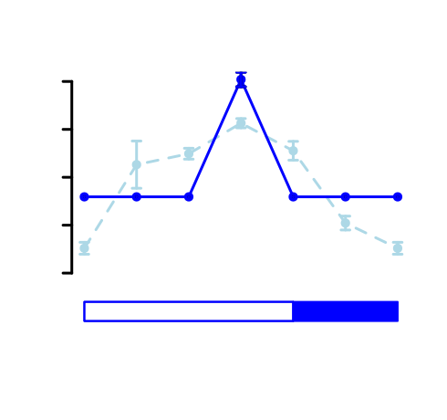
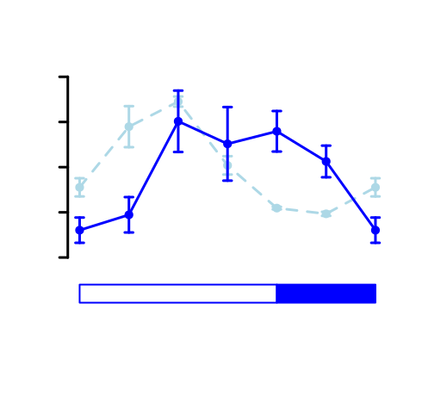





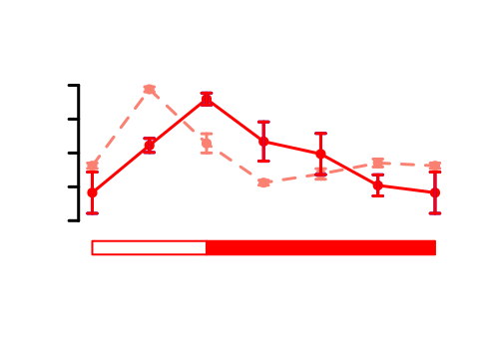
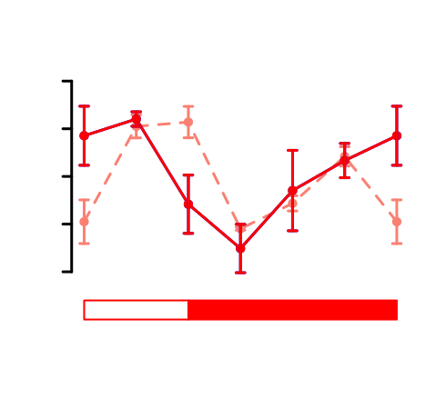



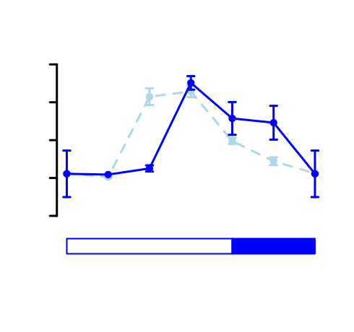
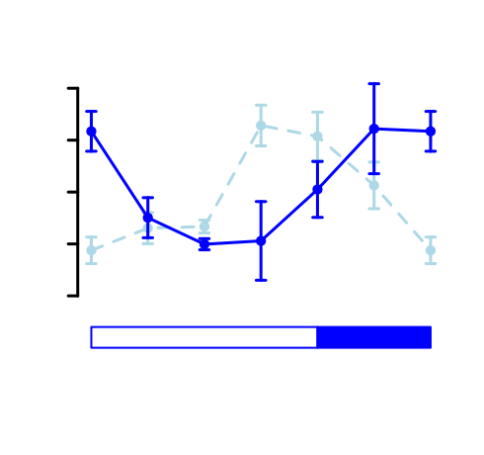
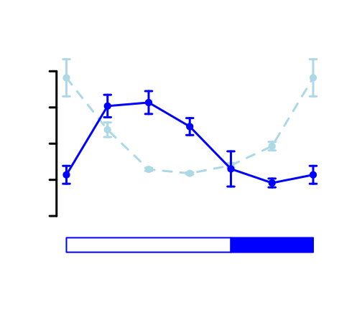
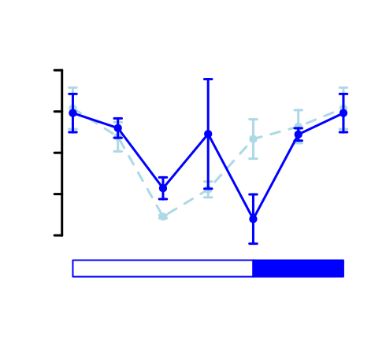



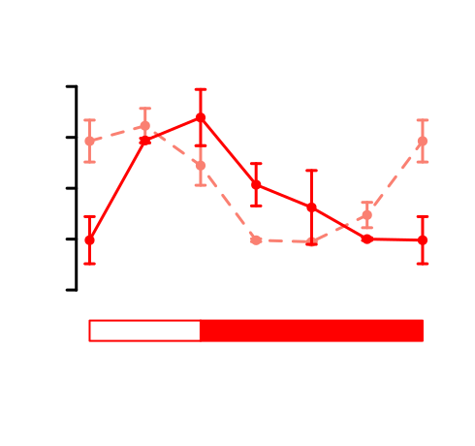
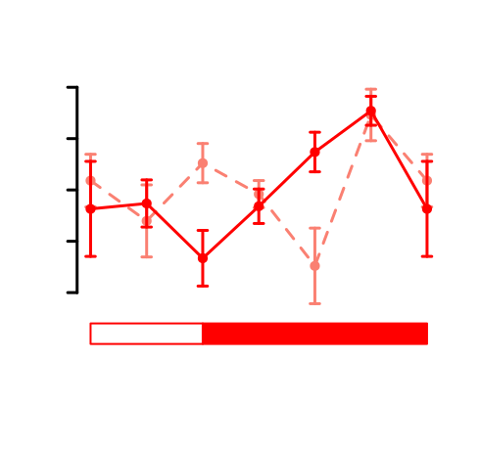
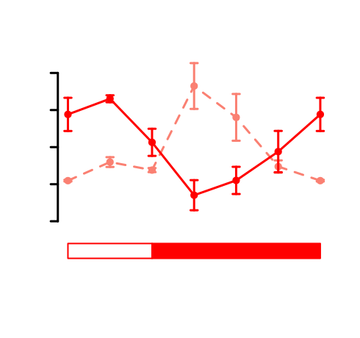
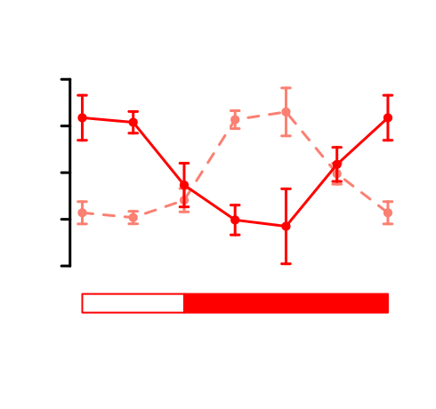



(A)
low
high
(B)
ZT0
ZT0
S Phase
Cells
S Phase
Proteins
ZT20
ZT4
ZT4
ZT20
S Phase
Genes
G2|M
G2|M
G1
G2|M
G1
S
S
ZT0
ZT4
ZT8
ZT12
ZT16
ZT20
ZT0
G1
S
S Phase
Cells
ZT16
ZT8
ZT16
ZT8
S Phase
Proteins
ZT12
S Phase
Genes
ZT12
G1
S
G2|M
ZT0
ZT4
ZT8
ZT12
ZT16
ZT20
ZT0
(C)
(D)
(E)
VDE - ostta16g00660
ZEP - ostta16g00670
Fv/Fm
Fv/Fm
Scaled Gene Expression
Protein Abundance
Scaled Gene Expression
Protein Abundance
Photosynthesis
Proteins
Photosynthesis
Genes
Vx
Vx
ZT0
ZT4
ZT8
ZT12
ZT16
ZT20
ZT0
Ax
Ax
Zx
VDE - ostta16g00660
Zx
ZEP - ostta16g00670
Fv/Fm
Fv/Fm
Scaled Gene Expression
Protein Abundance
Scaled Gene Expression
Protein Abundance
Photosynthesis
Proteins
Photosynthesis
Genes
ZT0
ZT4
ZT8
ZT0
Vx
Vx
ZT12
ZT16
ZT20
Ax
Ax
Zx
Zx
(F)
(G)
APL - ostta07g03440
AMY - ostta10g00260
NR - ostta10g00920
GS - ostta01g05020
Scaled Gene Expression
Protein Abundance
Scaled Gene Expression
Protein Abundance
Scaled Gene Expression
Protein Abundance
Scaled Gene Expression
Protein Abundance
Starch
Starch
Activity
Activity
APL - ostta07g03440
AMY - ostta10g00260
NR - ostta10g00920
GS - ostta01g05020
Scaled Gene Expression
Protein Abundance
Scaled Gene Expression
Protein Abundance
Scaled Gene Expression
Protein Abundance
Scaled Gene Expression
Protein Abundance
Starch
Starch
Activity
Activity

Slide 2
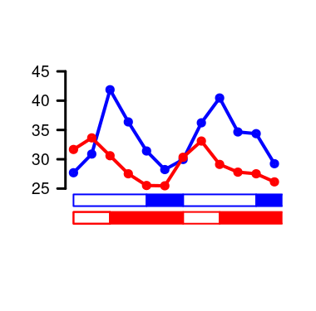
(A)
low
high
(B)
ZT0
ZT0
S Phase
Cells
S Phase
Proteins
ZT20
ZT4
ZT4
ZT20
S Phase
Genes
G2|M
G2|M
G1
G2|M
G1
S
S
ZT0
ZT4
ZT8
ZT12
ZT16
ZT20
ZT0
G1
S
S Phase
Cells
ZT16
ZT8
ZT16
ZT8
S Phase
Proteins
ZT12
S Phase
Genes
ZT12
G1
S
G2|M
(C)
(C)
(D)
(E)
ZT0
ZT4
ZT8
ZT12
ZT16
ZT20
ZT0
VDE - ostta16g00660
ZEP - ostta16g00670
Fv/Fm
Fv/Fm
Scaled Gene Expression
Protein Abundance
Scaled Gene Expression
Protein Abundance
Photosynthesis
Proteins
Photosynthesis
Genes
Vx
Vx
ZT0
ZT4
ZT8
ZT12
ZT16
ZT20
ZT0
Ax
Ax
Zx
VDE - ostta16g00660
Zx
ZEP - ostta16g00670
Fv/Fm
Fv/Fm
Scaled Gene Expression
Protein Abundance
Scaled Gene Expression
Protein Abundance
Photosynthesis
Proteins
Photosynthesis
Genes
ZT0
ZT4
ZT8
ZT0
Vx
Vx
ZT12
ZT16
ZT20
Ax
Ax
Zx
Zx
(F)
(G)
(I)
Starch Content (%DW)
APL - ostta07g03440
AMY - ostta10g00260
NR - ostta10g00920
GS - ostta01g05020
Scaled Gene Expression
Protein Abundance
Scaled Gene Expression
Protein Abundance
Scaled Gene Expression
Protein Abundance
Scaled Gene Expression
Protein Abundance
Starch
Starch
Activity
Activity
APL - ostta07g03440
AMY - ostta10g00260
NR - ostta10g00920
GS - ostta01g05020
Scaled Gene Expression
Protein Abundance
Scaled Gene Expression
Protein Abundance
Scaled Gene Expression
Protein Abundance
Scaled Gene Expression
Protein Abundance
Starch
Starch
Activity
Activity

Slide 3
ZT0
ZT0
ZT20
ZT4
ZT20
ZT4
ZT16
ZT8
ZT16
ZT8
ZT12
ZT12
G1/S → ZT12 / ZT16
S/G2 → ZT20 / ZT0
G2/G1 → ZT4 / ZT8 (M)
G1/S → ZT8 / ZT12
S/G2 → ZT16 / ZT20
G2/G1 → ZT0 / ZT4 (M)

Slide 4












(A)
(B)
FPKM
Number of Genes
(C)
ZT0
ZT8
ZT16
ZT4
ZT12
ZT20
ZT24
Amplitude (FPKM)
FPKM
Number of Genes
ZT0
ZT8
ZT16
ZT4
ZT12
ZT20
ZT24
(D)
(E)
(F)
FPKM
Number of Genes
Non rhythmic
Single peak
Two peaks
(G)
(H)
Low Gene
Expression
High Gene
Expression
H₂N
O
Ribosome
Biogenesis
Protein
Catabolism
O
NH₂
OH
ZT0
ZT0
NH₂
OH
NH₂
OH
O
Amino Acid
Metabolism
Translation
Carbohydrate
Metabolism
Photosynthesis
ZT20
ZT4
ZT20
ZT4
ZT16
ZT8
Translation
ZT16
ZT8
Intracellular
Transport
Photosynthesis
Amino Acid
Metabolism
DNA
Replication
Carbohydrate
Metabolism
O
ZT12
H₂N
O
NH₂
OH
ZT12
DNA
Replication
NH₂
OH
NH₂
OH
Ribosome
Biogenesis
O

